Slide 1
Superstore Marketing campaign
Represented by Ziad Ehab
Supervisor DR Doaa Mahmoud

Slide 2
Table of Contents
01
04
02
03
About project
Imbalanced data
EDA
05
Modeling and Evaluation
Missing values
06
Conclusion

Slide 3
01
About project

Slide 4
Context
superstore is planning for the year-end sale. They want to launch a new offer - gold membership, that gives a 20% discount on all purchases, for only $499 which is $999 on other days. It will be valid only for existing customers and the campaign through phone calls is currently being planned for them. The management feels that the best way to reduce the cost of the campaign is to make a predictive model which will classify customers who might purchase the offer.

Slide 5
02
EDA

Slide 6
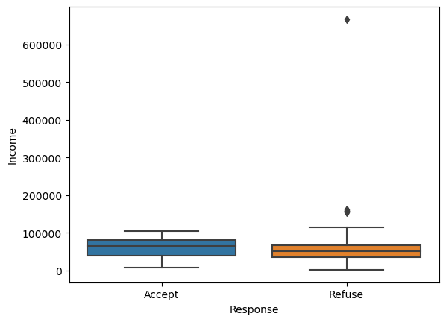
Income range for people refuse and accept the offer
There is no deference between people’s income ,they accept offer or refuse

Slide 7
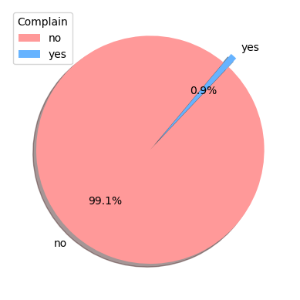
The percentage of people campaign in last 2 years
People who had complained in last 2 years , they about 1% and this is good indicator for the business

Slide 8
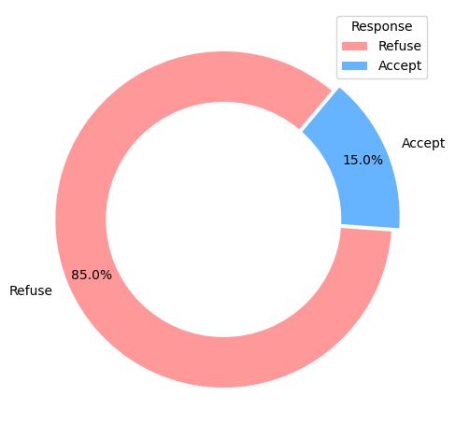
The percentage of people responded to marketing campaign in last 2 years
15% of people they accept the offer

Slide 9
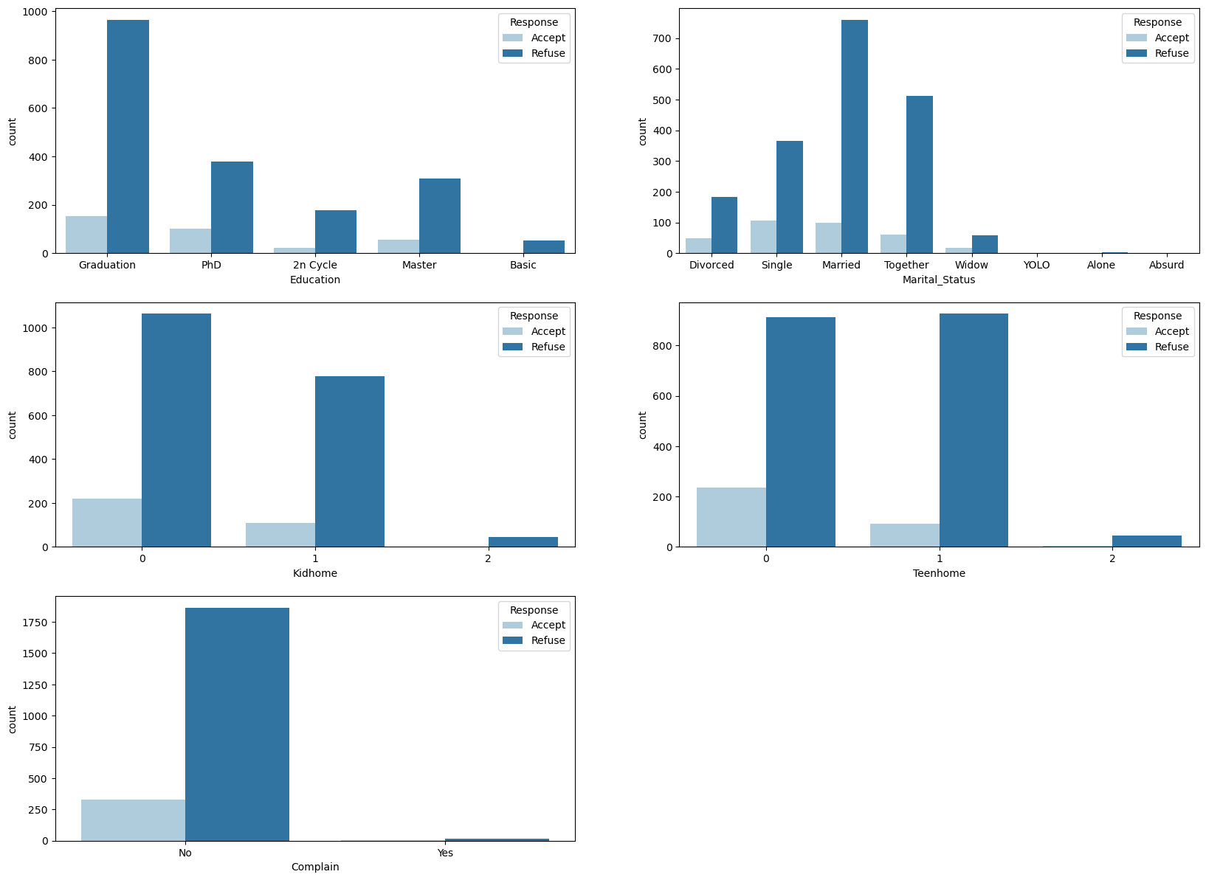
Who are responding with marketing campaign
Graduation , single ,married and people don’t have kids or teens. They are responding with marketing campaign

Slide 10
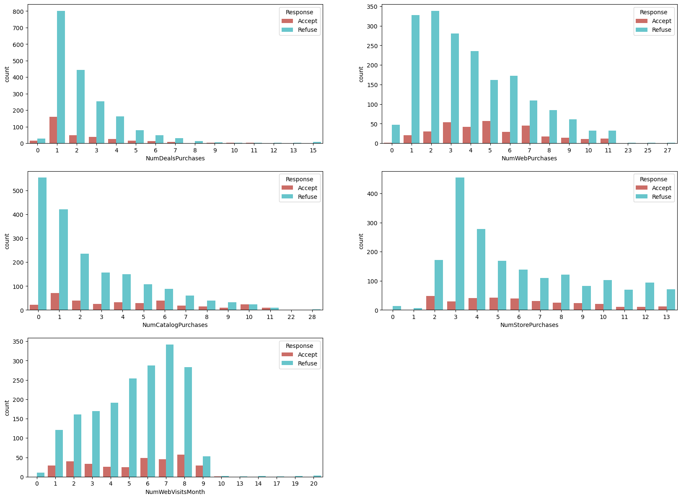
Ways to attract people to purchase
Number of purchasing in web and stores is higher than catalog pr deals

Slide 11
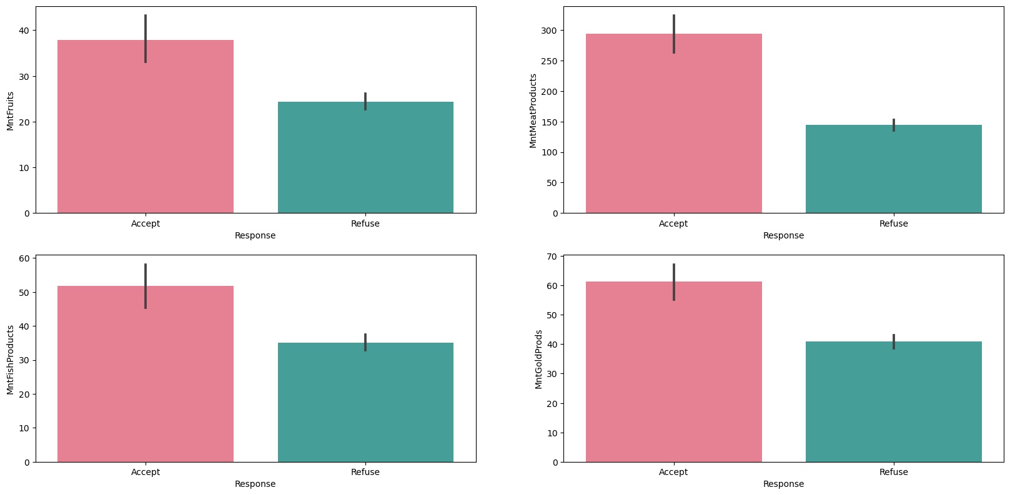
The impact of the marketing campaign
Here, is clear the last marketing campaign was successful because people responded with campaign, they bought more than others.

Slide 12
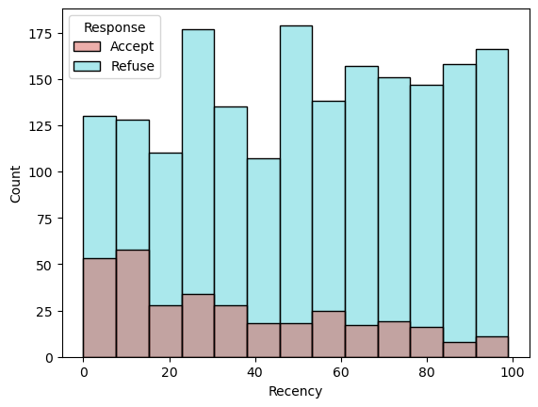
number of days since the last purchase
Recency decreases when people interact with marketing campaign

Slide 13
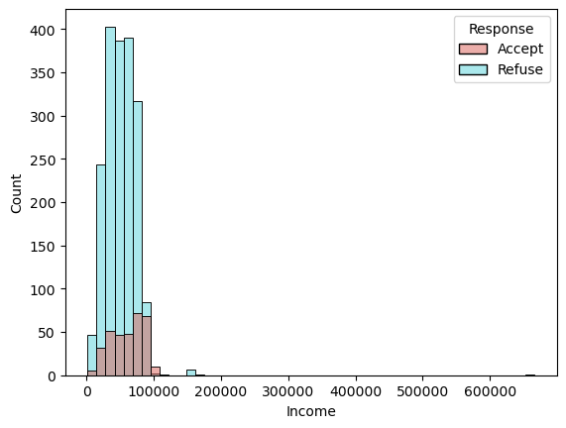
People’s income and response with campaign
Income increases when people accept the marketing campaign

Slide 14
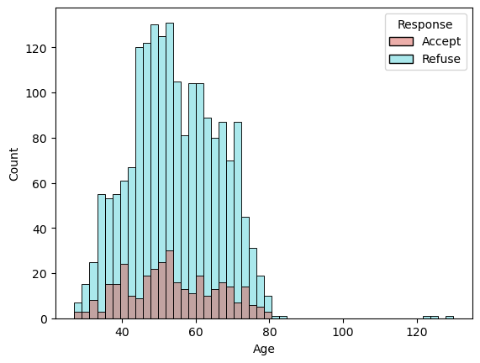
People’s ages and response with campaign
the age range that interact the with marketing campaign is 44 to 48

Slide 15
Missing values
03

Slide 16
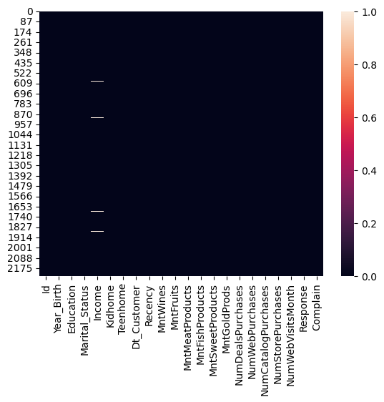
Missing values
there is no missing data except income column was 24 row and I removed it because it was lower than 1% of data

Slide 17
04
Imbalance data

Slide 18
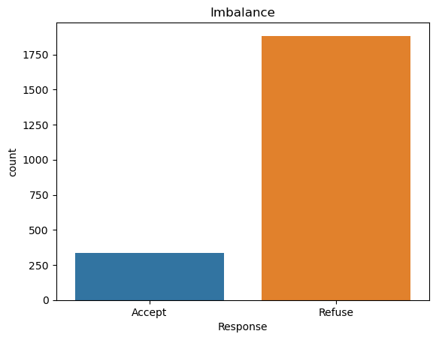
Is data imbalance ?
Data was imbalance 15% of people , they accept the model can’t predict well, but. I used SMOTE method to fix this problem.

Slide 19
Modeling and Evaluation
05

Slide 20
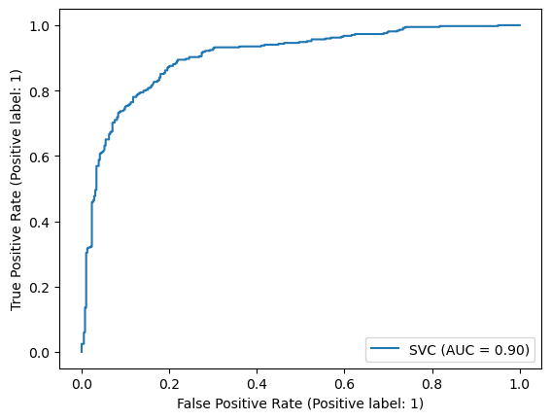
Modeling
precision recall f1-score support
0 0.85 0.82 0.83 383
1 0.82 0.85 0.83 369
accuracy 0.83 752
macro avg 0.83 0.83 0.83 752 weighted avg 0.83 0.83 0.83 752
support vector machine was the best model performance
And there’s no problem like overfitting or underfitting

Slide 21
06
conclusion

Slide 22
conclusion
The service is verry good because the complaints of customers is less than 1%. 15% of people accept the offer most of them are Graduation , single ,married and people don’t have kids or teens. People buy more amounts when they accept the campaign. web and stores the most effective way for target people, because they have frequent sales. Income increases when people accept the marketing campaign. People have 44 to 48 the most age accept the offer

Slide 23
Thanks!
Do you have any questions?
ziad.ehab15@yahoo.com

